Slide 1
Natural Language Processing
Unit 11 Semantic Analysis: Document Clustering
Faizan Javed
DataScience @ SMU

Slide 2
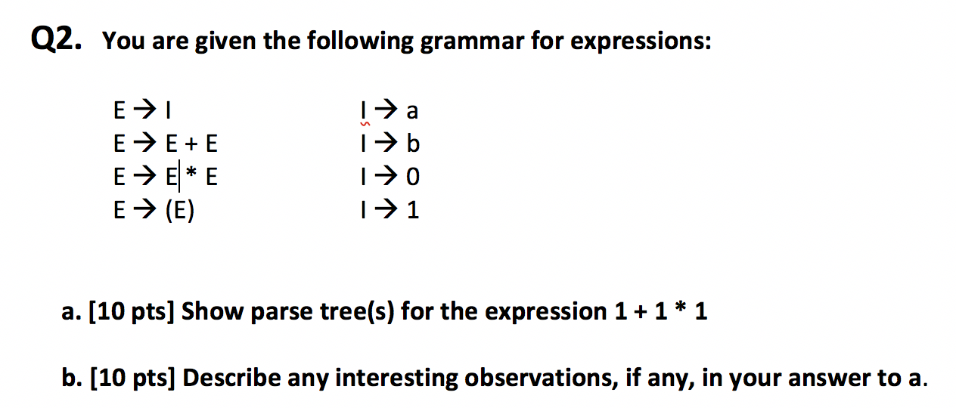
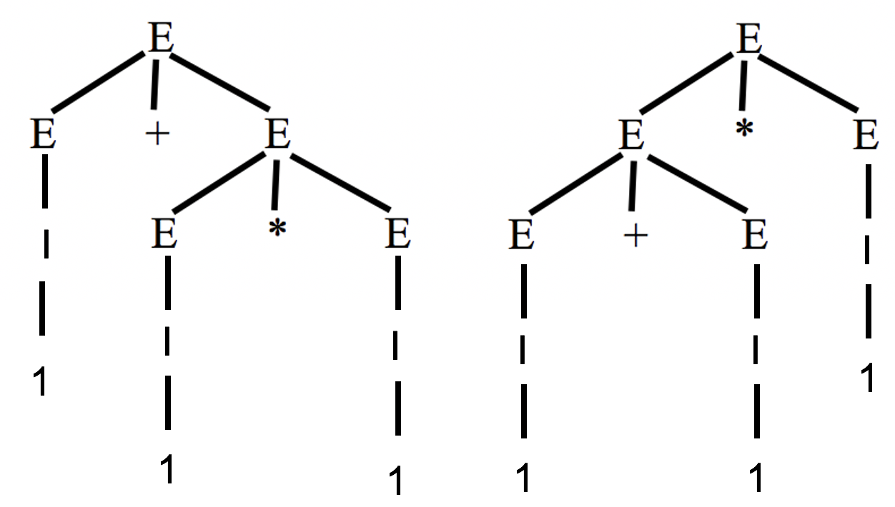
Midterm
The parse trees are ambiguous. Precedence of operators is not respected (multiplication * has higher precedence than addition +). Operators with same precedence can group from left or right. For different values of I, these parse trees would have different results (e.g 1+2*3). A solution to the ambiguity problem is to rewrite the grammar so that it becomes an unambiguous expression grammar.

Slide 3
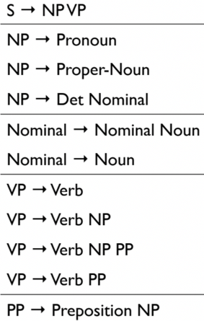
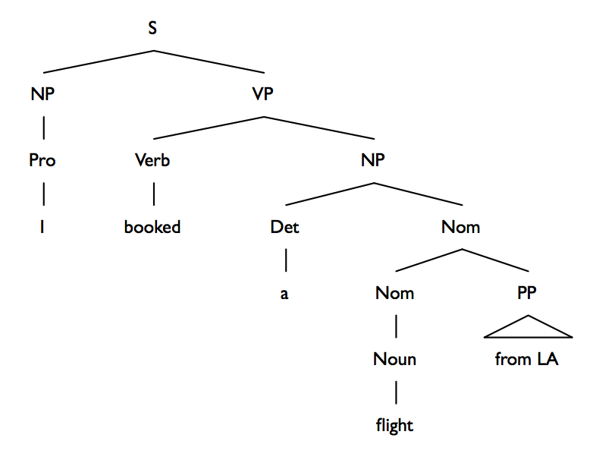
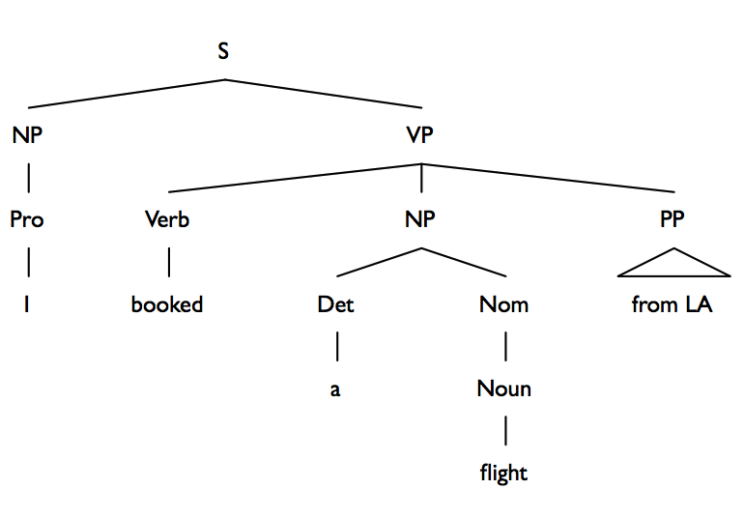
Q3. Consider the following grammar and sentence:
Sentence: I booked a flight from LA
a. [10 pts] In what way is this sentence ambiguous? Describe different interpretations of
this sentence.
“Booked a flight” from LA
Booked “a flight from LA”; “From LA” is a child of NP or VP.
b. [10 pts] Show the parse trees for this sentence and where the ambiguity manifests in the
parse trees.

Slide 4
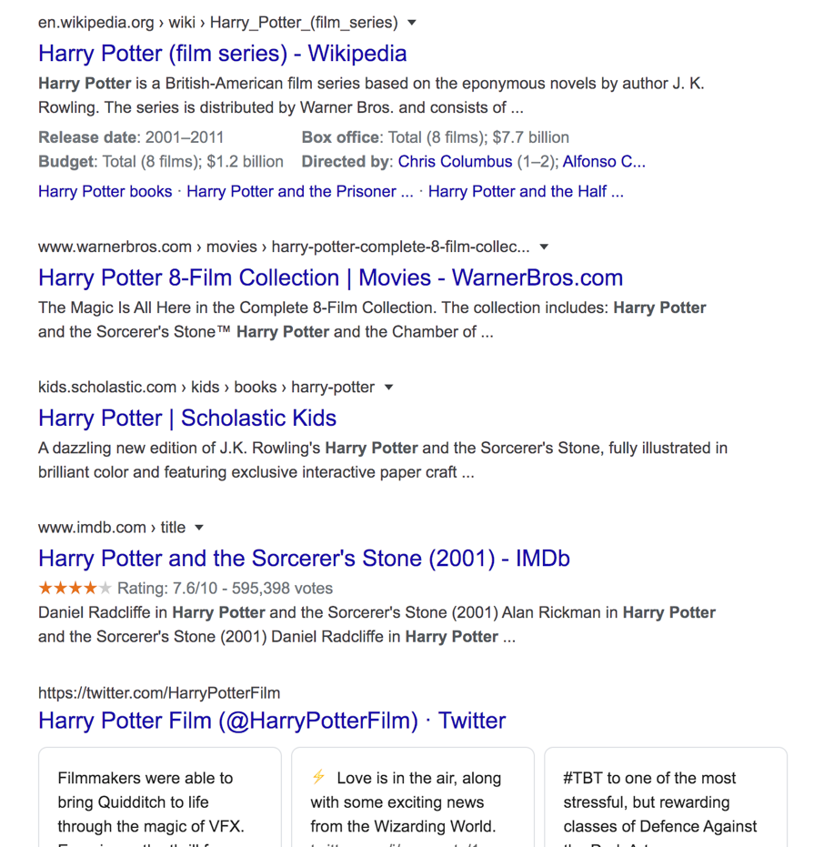
Q4. The image below shows Google search results for the query “harry potter”
As the results show, the query could represent any of the seven books in the
harry potter franchise, any of the film adaptations of the books, a theme park,
or a ride, an audiobook, cartoons, et al.
[10 pts] Discuss why google shows a mix of such results and what
factors can influence the search results for this query that will be presented to you.
Ambiguous query intent for the query “Harry Potter”. There are multiple
semantic interpretations of this query “harry potter book”, ”harry potter film”,
etc. User customer behavior data (clicks, etc.) can fine tune the rank order
of these interpretations.
Personalization: (if logged in) based on a user's previous visits and preferences,
The order of results will change and be more “personalized”.
For example, if the user has recently searched for theme parks, or has a history of searching for theme parks, the “harry potter theme parks” results will rank on top.

Slide 5
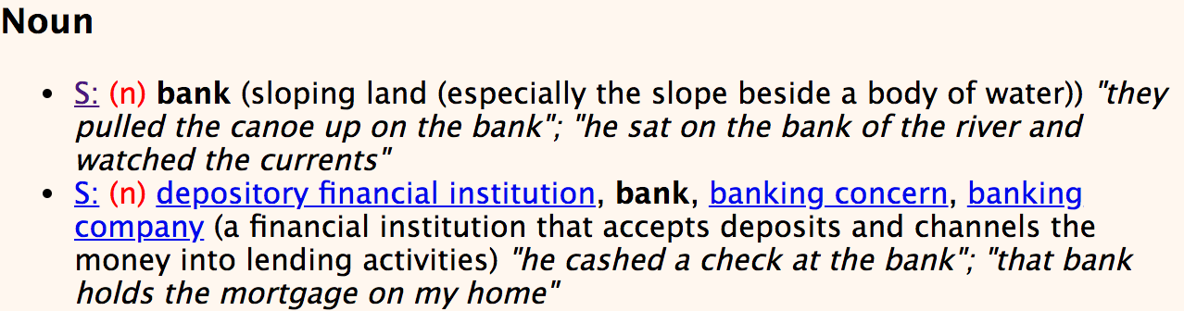
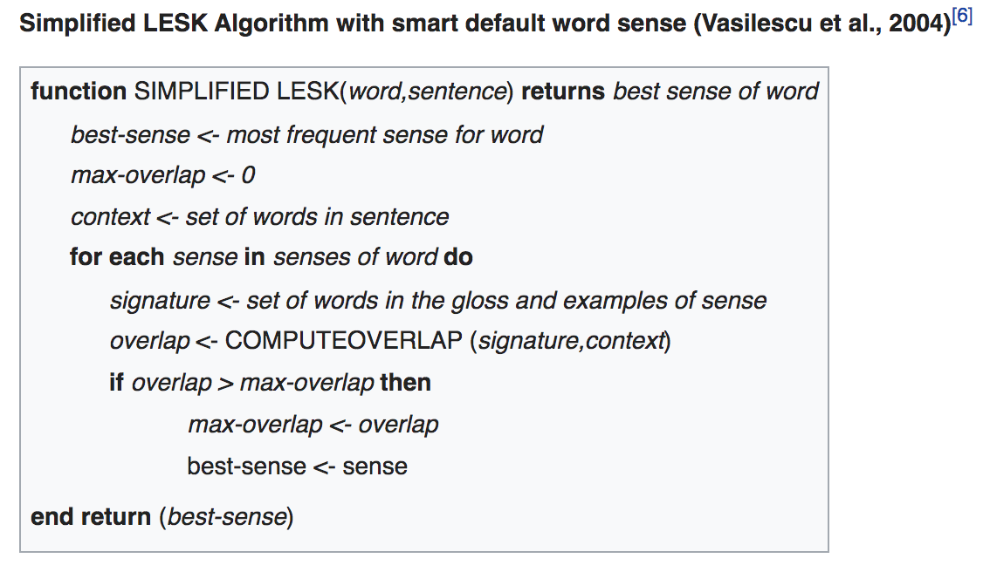
b. [15 pts] Consider the following sentence:
The bank can guarantee deposits will eventually cover future tuition costs because it invests in adjustable-rate mortgage securities.
The word bank has multiple senses. Use Wordnet to show the top two sense, glossaries and examples for bank and describe (at a high level) how you can use this information to find the proper sense for this word in a sentence.
Wordnet link: http://wordnetweb.princeton.edu/perl/webwn
1. For every sense of the word being disambiguated
count the amount of words that are in both
neighborhood of that word and in the dictionary
definition of that sense
2. The sense that is to be chosen is the sense which
has the biggest number of this count

Slide 6
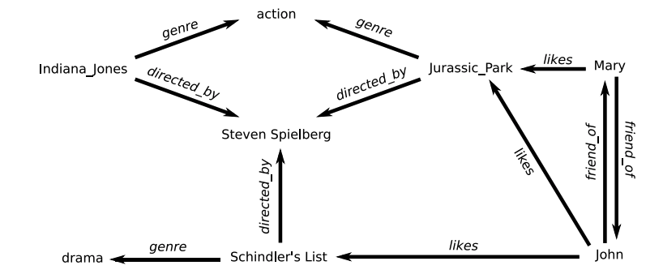
Q5. You are building an online moving streaming service which enables looking up information on movies, genres, directors, actors
and customer movie preferences.
**(Indiana Jones refers to Raiders of the Lost Ark (1981))
a. [10 pts] What is the customers intent (i.e. what are they looking for) with the following queries?
“Drama”, “Jurassic Park”, “Indiana Jones: Raiders of the lost ark”, “Steven Spielberg”
Individual queries, not part of a session. Broad vs narrow, content vs non-content queries
“Drama” - broad intent (category), looking for any drama content.
“Jurassic Park”/”Indiana Jones” – narrow intent: want a specific movie.
“Steven Spielberg” - broad intent (director), looking for any drama content.
b. [5 pts] A customer searches for “Indiana Jones” but clicks on and watches “Jurassic Park” – what insights can you get from this customer action? There is a relationship between the two movies, whether its in the form of similar categories or similar directors/actors, etc.
c. [10 pts] The customer searches for “Indiana Jones: Raiders of the lost Ark” but it’s not available in their region (US, EU, Asia). What search results would you show the customer? Discuss how you would build that experience from a technical design perspective.
Show results that are similar to the movie and feature the same actors and director/producer.
Define a query and context model: context is name of the movie that was clicked, query is the full query text (not individual words).
Two queries are in the same context if they both lead to the same movie. Get related queries from the knowledge graph for query expansion:
E.g., for “Indiana jones” --> “action”, “Steven Spielberg” “Jurassic park”

Slide 7
Document clustering
Unsupervised machine learning
Organize a corpus of documents into various groups based on some features/attributes/properties of the documents.
How does it differ from document classification?

Slide 8
Centroid-based clustering models (k-means, k-medoid, “bisecting” k-means, et al)
Each cluster has a central representative member that represents each cluster and has features that distinguish that cluster from others.
Define distance metric (cosine, jaccard, manhattan, etc)
Value of ”k”
Hierarchical clustering models (connectivity-based models)
Creates a nested sequence of partitions, with a single, all inclusive cluster at the top
and singleton clusters of individual points at the bottom.
Each intermediate level can be viewed as combining two clusters from the next
lower level (or splitting a cluster from the next higher level).
Resulting tree is called a dendogram.
a) Agglomerative (bottom up): Start with the points as individual clusters and, at each step, merge the most similar or closest pair of clusters. This requires a definition of cluster similarity or distance.
b) Divisive(top down): Start with one, all-inclusive cluster and, at each step, split a cluster until only singleton clusters of individual points remain. In this case, we need to decide, at each step, which cluster to split and how to perform the split.

Slide 9
Hierarchical clustering methods are usually “better” than centroid methods but slower. (quality vs efficiency)
Hierarchical clustering is often portrayed as the better-quality clustering approach but is limited because of its quadratic time complexity.
K-means and its variants have a time complexity which is linear in the number of documents but are thought to produce inferior clusters.
“Hybrid approach” – best of both worlds
Use cases:
Improving the precision or recall in information retrieval systems and as an efficient way of finding the nearest neighbors of a document.
Creating and browsing a collection of documents
Organizing the results returned by a search engine in response to a user’s query
Automatically generate hierarchical clusters of documents (generating a taxonomy, e.g., Amazon ecommerce, Yahoo News, etc.)

Slide 10
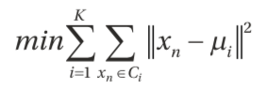
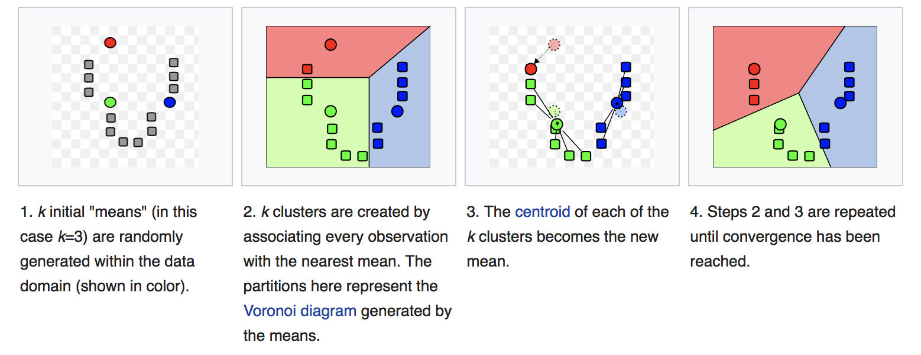
k-Means ..
Goals: cluster data points into k groups by creating a centroid for each group, Minimize within-cluster sum-of-squares (mu is centroid)
Find the underlying structure of data / create groups or segments of data

Slide 11
k-Means algorithm:
Randomly pick k-centroids in d-space (algorithms exist for initializing centroids that converge more effectively, e.g., kmeans++)
Assign each data point to the closest centroid (using a nearness measure such as Euclidean distance)
Move centroid to the average location of all data points.
Repeat until algorithm converges (i.e., centroids don’t change much)

Slide 12
Problems with k-means
Final cluster configuration depends on initial centroid allocation
Need to choose the value of k (use cross validation, elbow method, et al)
Convergence issues: algorithm can fall into a loop, bouncing back and forth between two solutions (in most practical situations, kmeans converges but can be stuck at a local minima)
Interpretability can be a problem: sometimes the answer isn’t useful

Slide 13
….however, kmeans is fast compared to other clustering algorithms and has broad applications (customer segmentation, taxonomy construction, etc.
Large scale k-means clustering: see
Scalable K-means by Ranked Retrieval, Google, WSDM’14. https://static.googleusercontent.com/media/research.google.com/en//pubs/archive/42853.pdf

Slide 14
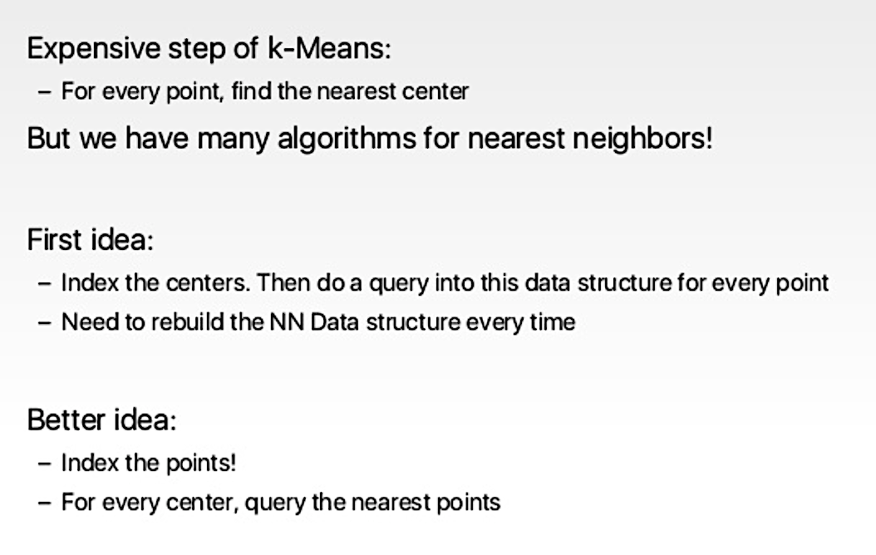

Slide 15
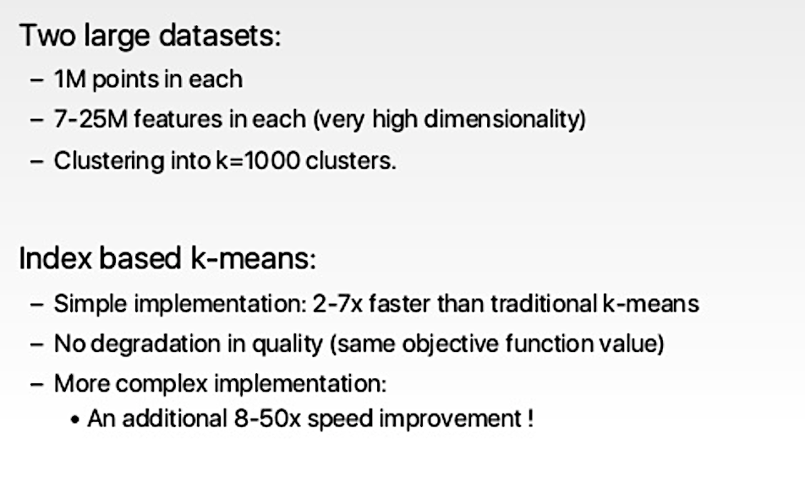

Slide 16
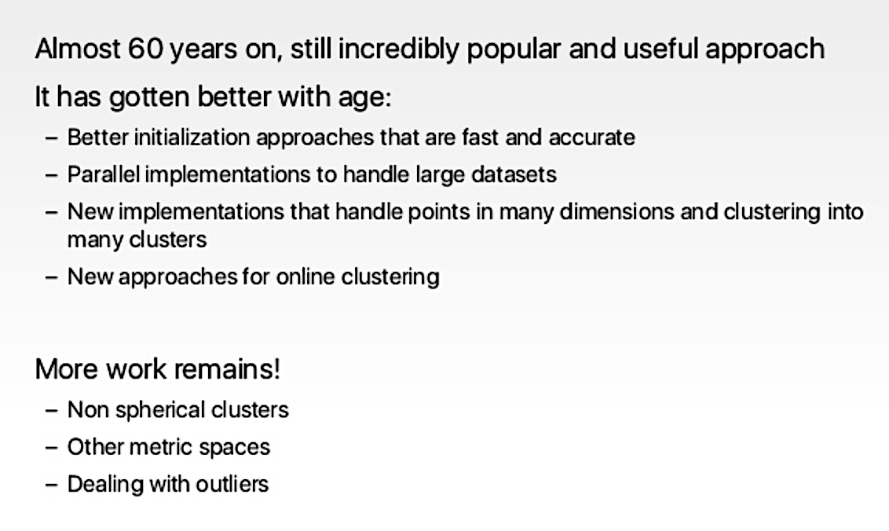

Slide 17
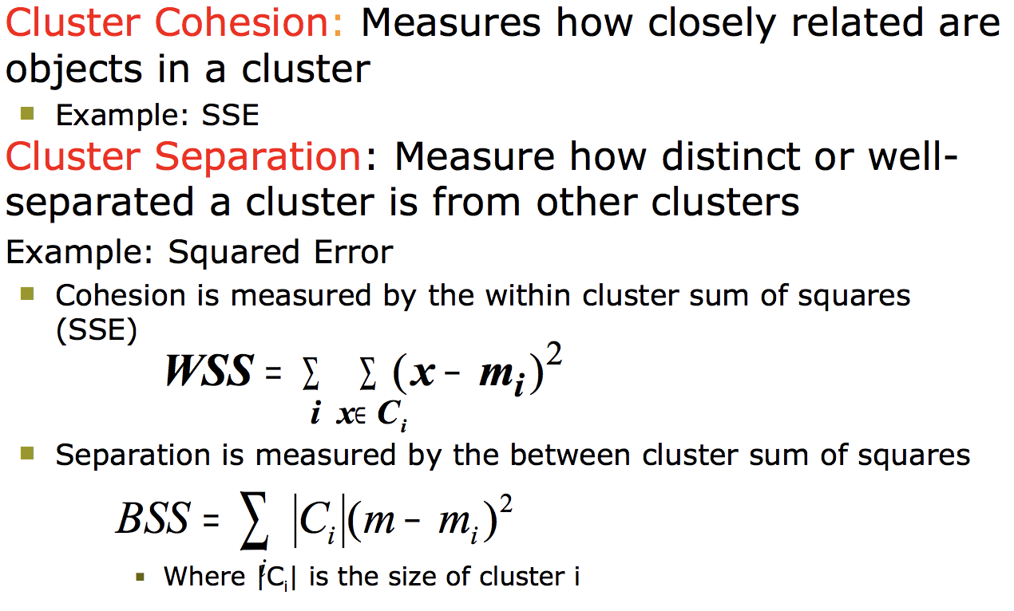
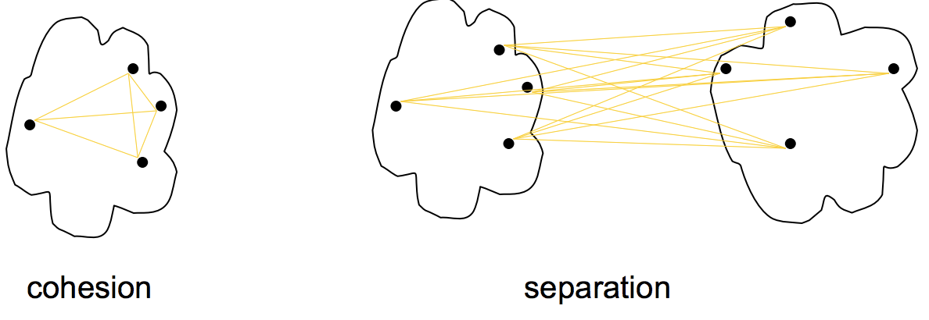
Evaluation of Cluster Quality “clusters are in the eye of the beholder”! A comparison of document clustering techniques http://www.stat.cmu.edu/~rnugent/PCMI2016/papers/DocClusterComparison.pdf
Internal quality measure :
measure the goodness of a clustering structure without respect to external information.

Slide 18
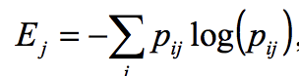
Evaluation of Cluster Quality “clusters are in the eye of the beholder”! A comparison of document clustering techniques http://www.stat.cmu.edu/~rnugent/PCMI2016/papers/DocClusterComparison.pdf
External quality measures: measure the extent to which cluster labels match externally supplied class labels.
1. Entropy: for each cluster compute the probability that a member of that cluster belongs to a specific class.
Entropy of each cluster over all classes:
2. F-measure: Treat each cluster as if it were the result of a query and each class as if it were the desired set of documents for a query.
Calculate the recall and precision of that cluster for each given class.
More specifically, for cluster j and class I,
Recall( i, j ) = nij / ni , Precision( i, j ) = nij / nj
where nij is the number of members of class i in cluster j,
nj is the number of members of cluster j and ni is the number of members of class i.
The F measure of cluster j and class i is then given by
F(i, j) = (2 * Recall( i, j ) * Precision( i, j )) / ((Precision( i, j ) + Recall( i, j ))

Slide 19
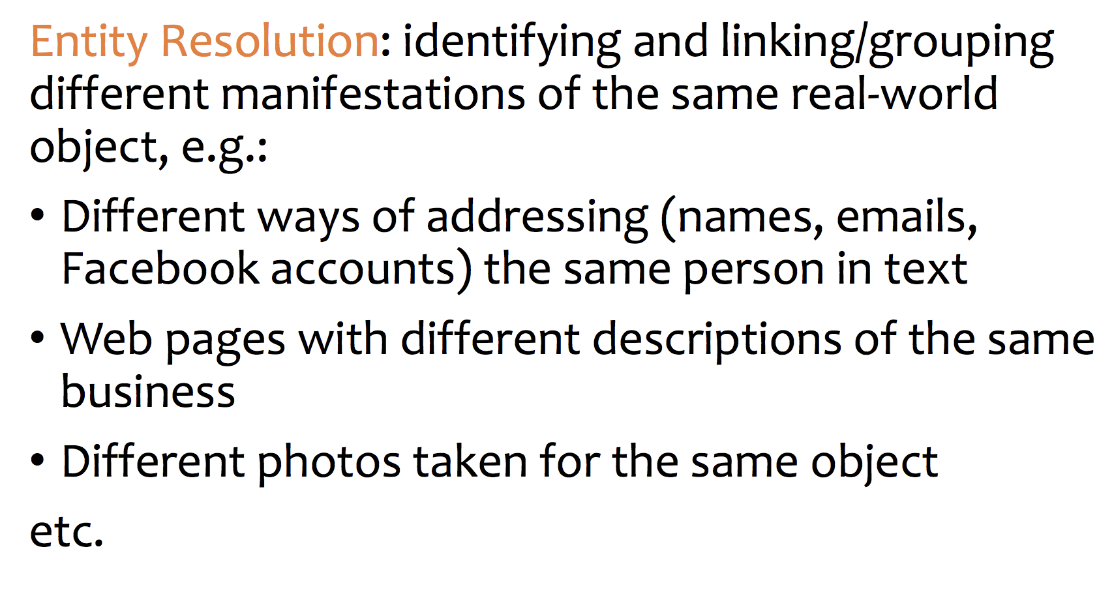
Entity Resolution / Document deduplication

Slide 20
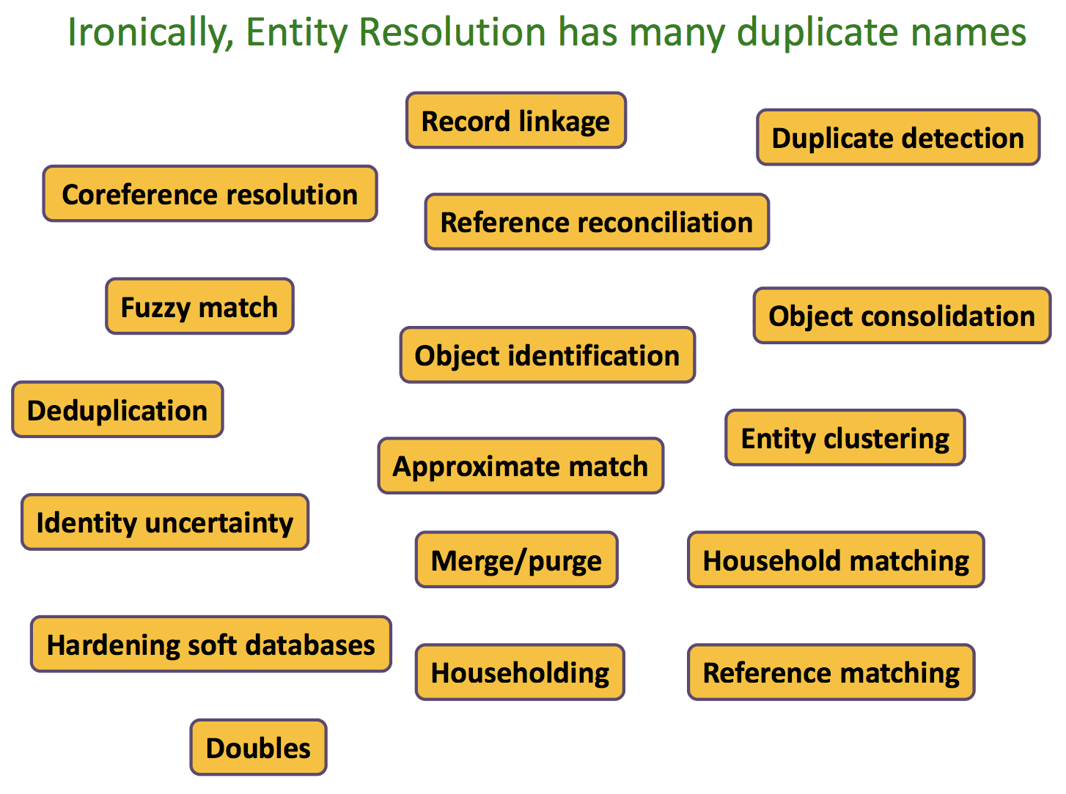

Slide 21
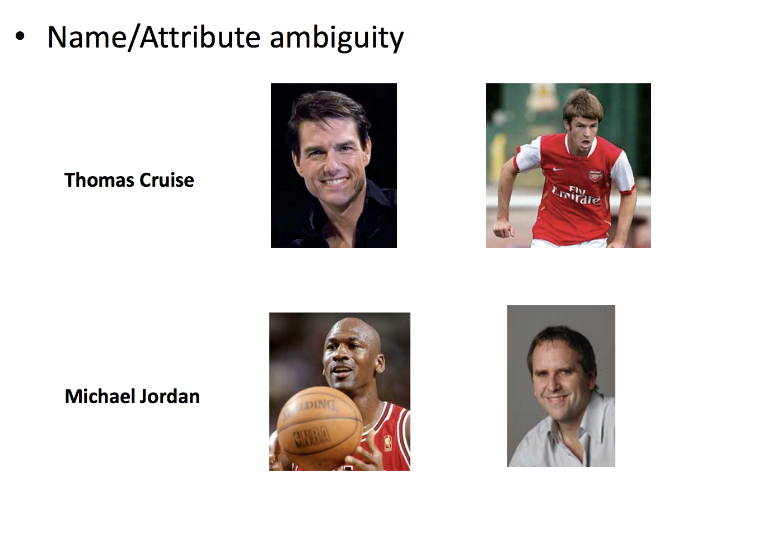

Slide 22
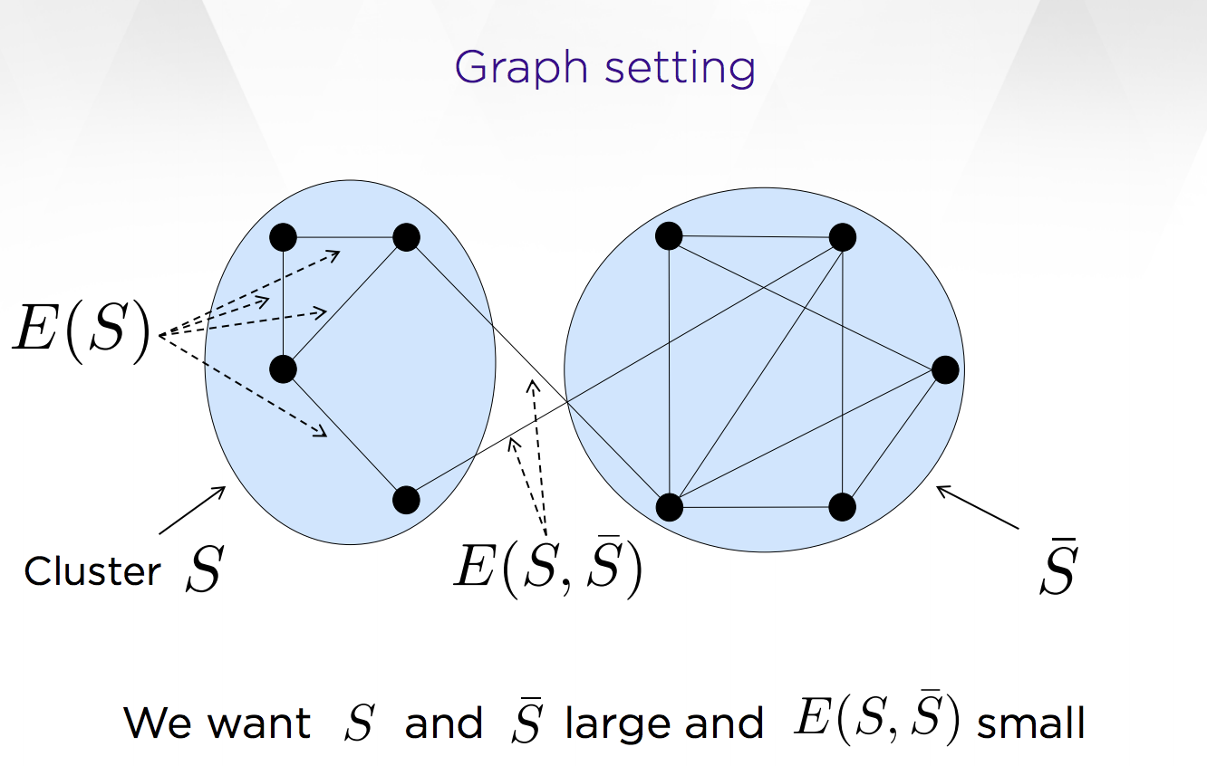
Correlation clustering From Theory to Practice https://www.researchgate.net/publication/266660481_Correlation_clustering_from_theory_to_practice

Slide 23
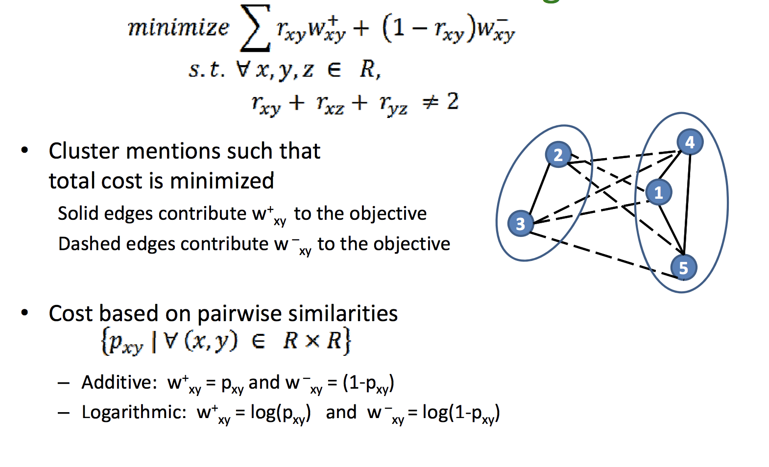

Slide 24
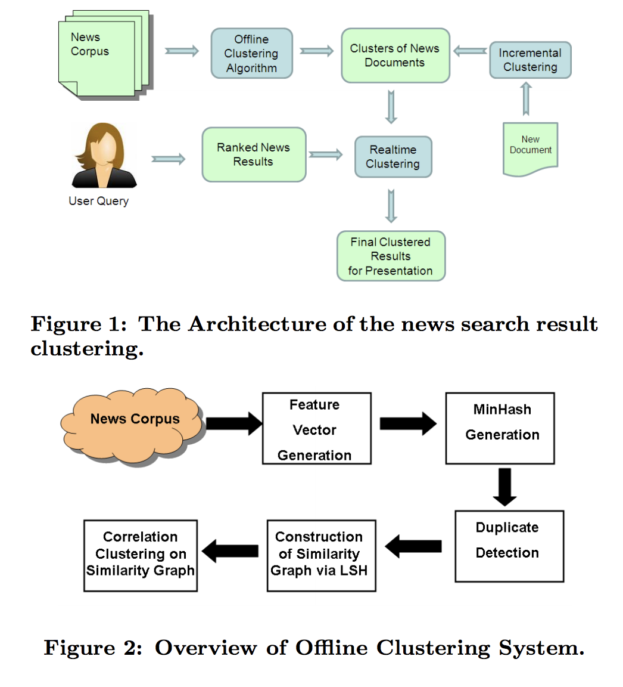
Scalable Clustering of News Search Results Yahoo Research, WSDM’11 http://www.yichang-cs.com/yahoo/wsdm11_onlineclustering.pdf

Slide 25
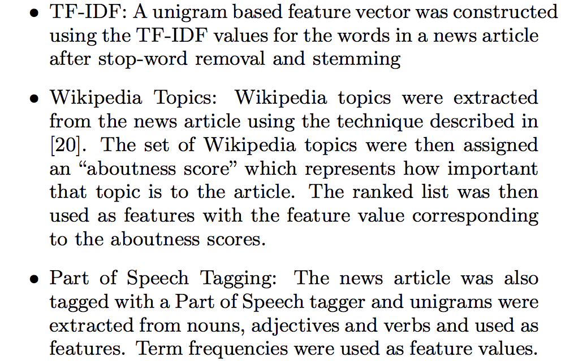
Scalable Clustering of News Search Results – document features Yahoo Research, WSDM’11 http://www.yichang-cs.com/yahoo/wsdm11_onlineclustering.pdf

Slide 26
A similarity graph is then constructed using the output of the LSH (hashing) process. Each article is represented as a node in the graph and an edge exists between two nodes if its similarity exceeds the threshold. The edges are also weighted by the cosine similarity measure.
The similarity graph is then fed into a correlation clustering algorithm ..to partition the graph into clusters. Correlation clustering ...attempts to minimize a cost function based on the number of dissimilar pairs in the same cluster and the number of similar pairs in different clusters
An important characteristic of the correlation clustering approach is that it does not require the specification of the number of clusters. This feature is important as it is not easy to guess the number of clusters in an evolving corpus in which a major news event can trigger multiple stories over a few days.

Slide 27
What did you learn today?
Questions?

